Slide 1
The basic economic problem

Slide 2
“Economics”
“Economics is the science which studies human behavior as a relationship between ends and scarce means that have alternative uses” (Lionel Robbins)
“Economy is the art of making the most of life” (George Bernard Shaw)

Slide 3
Problem 1: Resources are scarce
Problem 2: Human wants are unlimited
Problem 3: Scarce resources have alternative uses
Problem 4: We must choose which wants to Satisfy

Slide 4
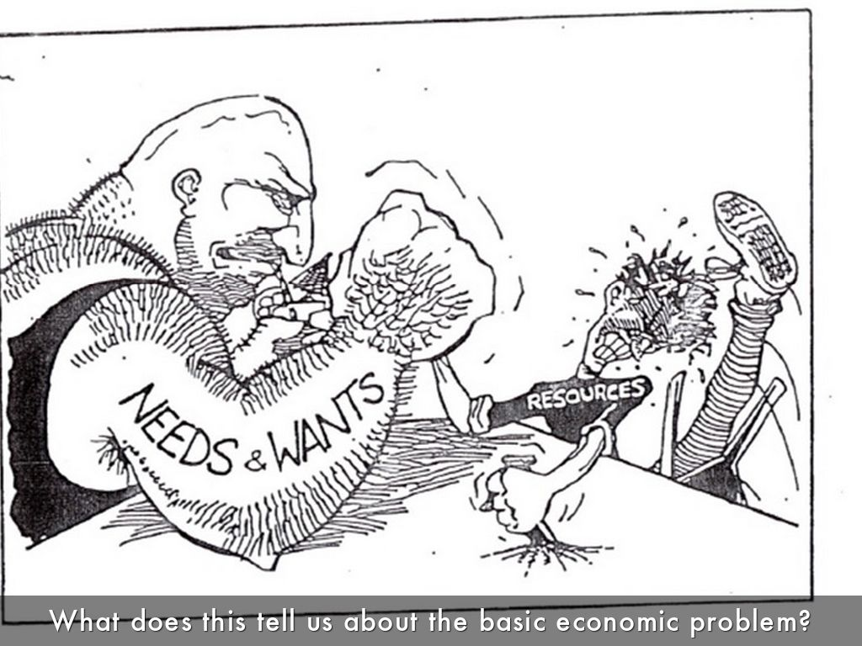

Slide 5
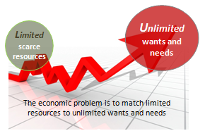

Slide 6

Needs & Wants
Problem 2: Human wants are unlimited
Wants
include those desires that you
are able and also unable to pay for.
• They are unlimited.
The term need applies to the bare
minimum physical necessities that allow you to survive: bare minimum of basic food, shelter, and clothing.

Slide 7
Make your list
Needs
Wants
Limit your wants to no more than 25 items please!
Notes:
Students have 15 minutes to draw the table and complete.
What students should realize here that wants are unlimited. We always want more and more.

Slide 8
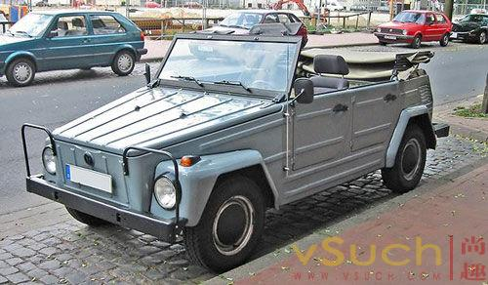

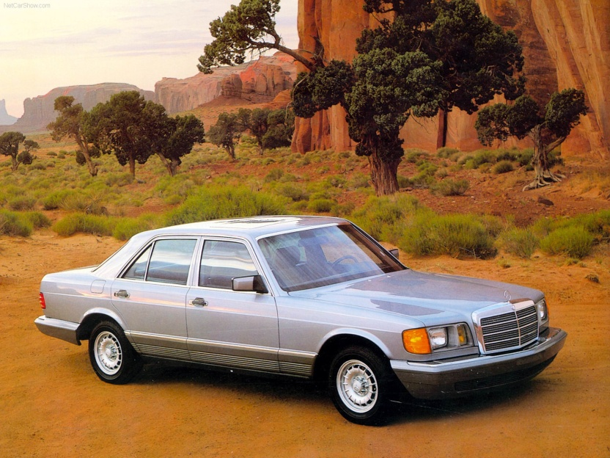
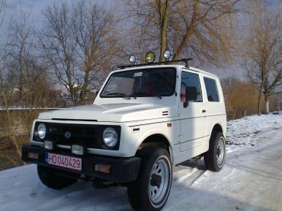
Unlimited wants
Do wants change as we age?
Describe a change in wants.

Slide 9
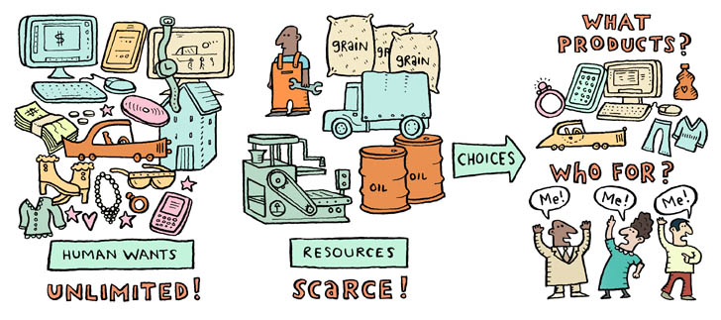
The basic economic problem
We must choose which wants to Satisfy
Human wants are unlimited but resources are scarce

Slide 10
The basic economic problem
SCARCE RESOURCES
There are only a limited number of resources such as workers, machines, factories, raw materials etc.
There are a number of different ways in which they could be used.
Similarly people only have a limited amount of money. Yet they have lots of needs and wants to satisfy.
Government has a limited amount of money!!! However, it is unable to satisfy all its wants.
Notes:
https://www.youtube.com/watch?v=W35X_vddDjQ

Slide 11


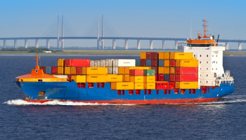
Free good
Is a good with zero opportunity cost
No resources to make them
Economic good
Which requires resources to produce it.
Has an opportunity cost

Slide 12

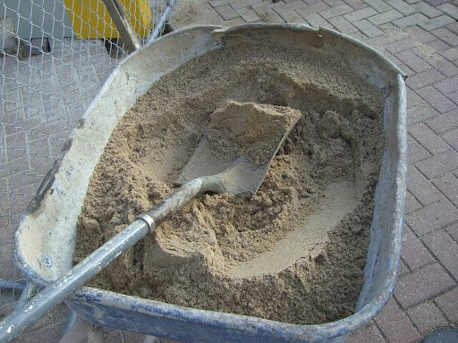
Economic goods & Free goods
Desert Sand
Sand at construction site
This is free and available
Allocative Mechanism
This not free and you have to pay for this sand.
Free good can be obtained from nature at anytime & any quantity such as; air, water from rivers & lakes.
No
Yes
Economic good is;
Scarce in relation to;
Its demand & supply
Human effort is required to obtain it (pay for it).

Slide 13

Factors of production
Problem 1: Resources are scarce
Natural resources = land
Man-made resources = capital
Human skills and effort = labour
Business know-how = enterprise
Activity 1.1

Slide 14
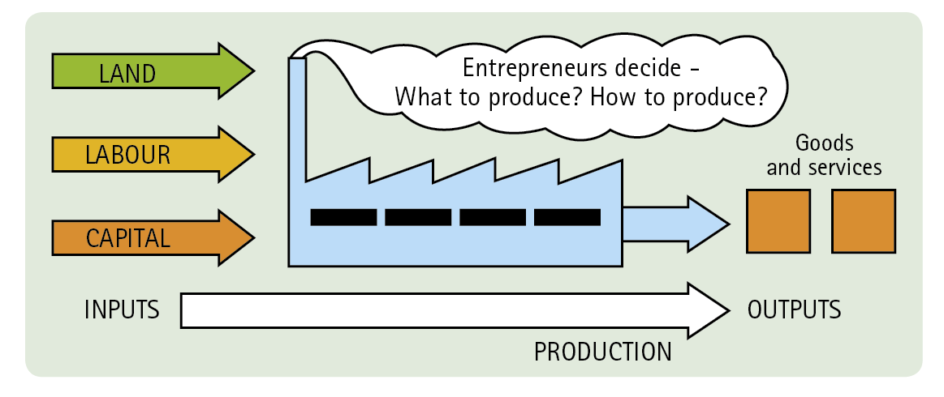
Production
Using inputs (resources) to make outputs (goods and services) to satisfy the needs and wants of consumers

Slide 15
Which factor of Production?
1) oil
2) a master’s degree
3) making a sandwich
4) screwdriver
5) Bill Gates
6) 20 years of being a plumber
7) soil
8) building
9) a robot
10) designing software

Slide 16
The Supply (quantity) of Land
The Quality of land
The Mobility of land
Make your own notes and present to the class
Occupational mobile
Geographically immobile

Slide 17
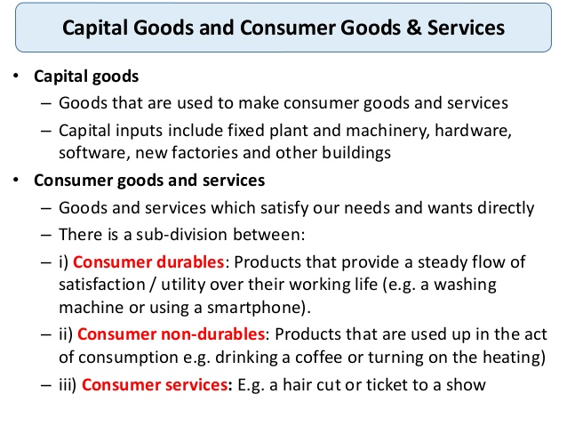

Slide 18
The Supply of Capital
Quality & Quantity of capital
The occupationally Mobility of Capital
Geographical mobility of capital
Investment : spending on capital goods
Depreciation: the value of capital goods that have worn out
Net Investment: gross investment less depreciation

Slide 19
The Quality of Labour
The Supply of Labour
What determines Supply of Labour ?
Size of population
Age structure of population
Retirement age
School leaving age
Attitude towards women
Workday(hours)/part-time/Overtime/Holiday
Mobility of Labour
Occupational immobility
Geographical immobility

Slide 20
Reasons for occupational immobility
If coal mines or steel factories closed down in South Wales, it may be very difficult for the unemployed coal miners to find work in new industries in the service sector.
They may lack relevant skills/confidence or motivation to work in completely new industries.
It may be difficult to receive training in areas where jobs are available.
People over a certain age (e.g. 55) may be pessimistic about their chances to learn new skills in higher-tech industries.

Slide 21
The Supply (quantity)of Entrepreneurs
Good education system
Low taxes
⬇⬇︎⬇︎⬇︎⬇︎ Government regulations
Immigration
Quality of Entrepreneurs
Education/health/training/Experience
More experience more chances successful
Some have failed ability to try again
Mobility of Entrepreneurs
Can organise in different industries
Jeff Bezos
Amazon is one of the biggest success stories of the online era. But before Amazon became a household name, the company’s CEO had several failed ideas. One of the most notable was an online auction site, which evolved into zShops, a brand that ultimately failed. Still, CEO Jeff Bezos would repurpose the idea into what would eventually become the Amazon Marketplace.

Slide 22
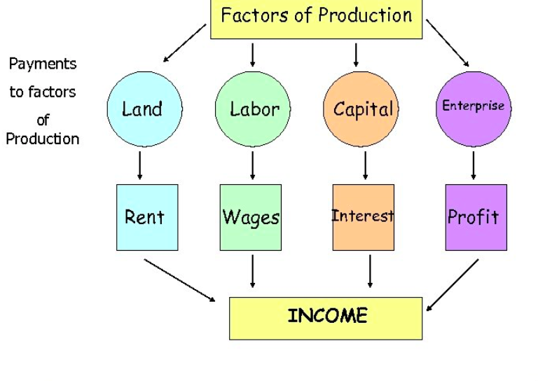

Slide 23
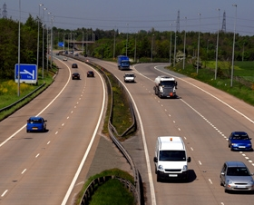
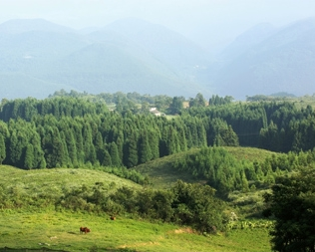
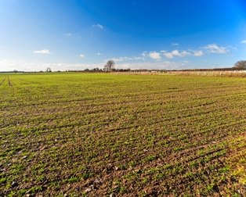
So, we all have to make choices
Scarce resources have alternative uses
There is a limited amount of resources such as raw materials, machines, factories and skilled workers. But there are a number of different ways in which they can be used.
CHOICE
CHOICE
Resource allocation therefore involves deciding how best to use scarce resources to satisfy as many needs and wants as possible

Slide 24
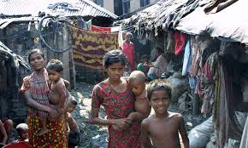

Some people have more choices than others

Slide 25
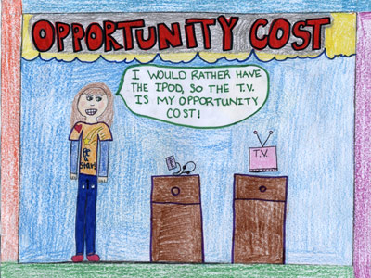
Economic Choices
When economists refer to the “opportunity cost” of a resource, they mean the value of the next-highest-valued alternative use of that resource.
If, for example, you spend time and money going to a movie, you cannot spend that time at home reading a book, and you can’t spend the money on something else.
If your next-best alternative to seeing the movie is reading the book, then the opportunity cost of seeing the movie is the money spent plus the pleasure you forgo by not reading the book….

Slide 26
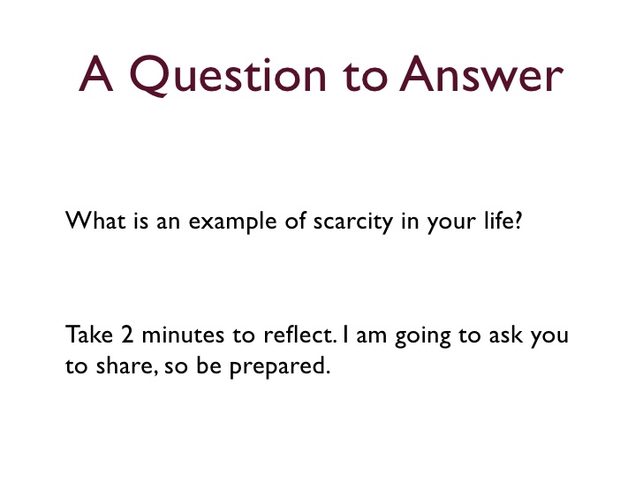

Slide 27






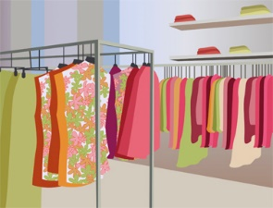
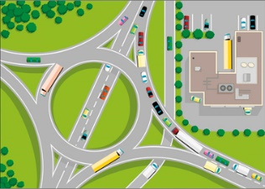
Choice
Similarly, people and governments only have a limited amount of money but have many needs and wants to satisfy
Consumer Governments
$100bn
$100
Food? Entertainment?
Clothing?
Defence? Health care?
Roads?

Slide 28
Choice and opportunity cost
Choice and opportunity cost are two fundamental concepts in economics. Given that resources are limited, producers, consumers and the Government have to make choices between competing alternatives.
All economic decisions involve making choices.
Task - Think of at least 2 economic decisions that individuals, Firms and Workers must have to make.
Workers
Firms

Slide 29
Trade-off
Trade-offs when making choices
Making a choice made normally involves a trade-off – this means that choosing more of one thing can only be achieved by giving up something else in exchange.
Housing: Choices about whether to rent or buy a home – there are costs and benefits to renting a property or in choosing to buy a home with a mortgage. Both decisions involve risk. People have to weigh up the costs and benefits of the decision.
Working: Do you work full-time or part-time? Is it worth your while studying for a degree? How have these choices been affected by the introduction of university tuition fees
Transport and travel: The choice between using Euro-Tunnel, a low-cost ferry or an airline when travelling to Western Europe.

Slide 30
Quiz
Define opportunity cost
Describe a opportunity cost for each of the following
Consumers
Workers
Producers
Government

Slide 31
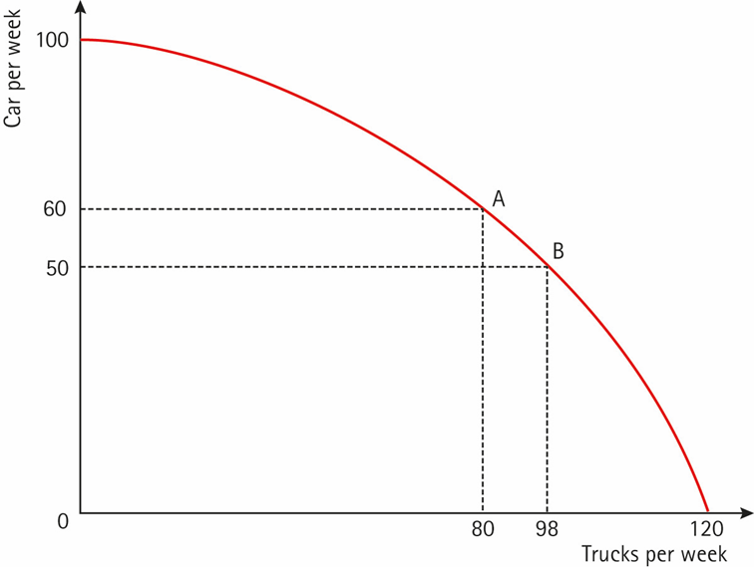
THE PRODUCTION POSSIBILITY FRONTIER OR CURVE
PPC runs between extremes of producing only one item or the other
Data is plotted on a graph; lines joining points is PPC
shows maximum number of one item relative to other item
PPC shows opportunity cost of each choice
more of one product means less of the other
*
Each point on PPC represents efficiency (producing the maximum amount of goods and services possible);
Points inside curve mean underutilization (producing fewer goods and services than possible);
Outside curve cannot be met (unattainable)
*

Slide 32
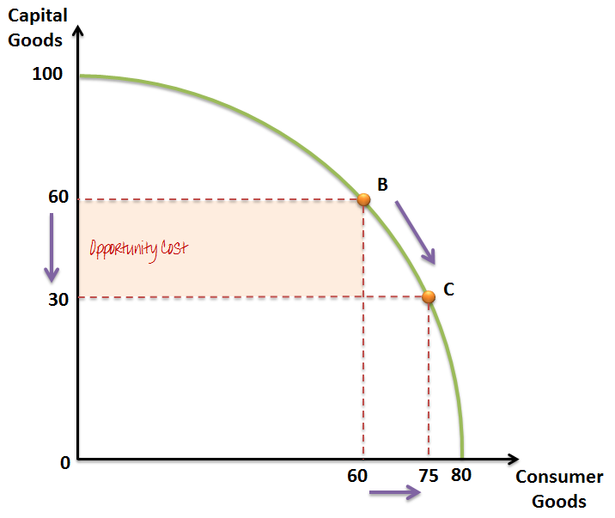
Movement along the a PPC

Slide 33
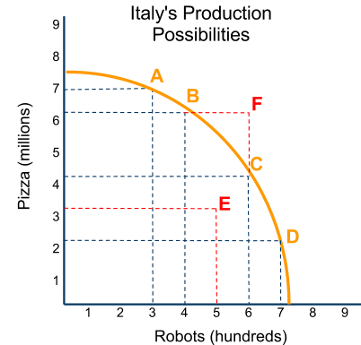
Consider the hypothetical PPC for the country of Italy
This model shows that Italy can produce:
Either 7.5 million pizzas,
OR 750 robots
Note, however, that Italy can NOT produce 7.5 million pizzas AND 750 robots
Con
Sumer
Goods
Capital Goods

Slide 34
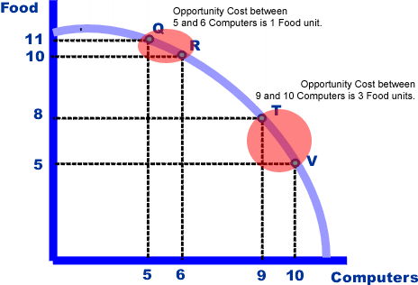
Increasing Opportunity Cost (PPF is concave)
As we move along the production possibility curve with increasing computer, more and more food must be forgone
INCREASING OPPORTUNITY COST:
Q to R = [(11 – 10)/(6 – 5)] = 1
T to V = [(8 – 5) /(10 – 9)] = 3

Slide 35
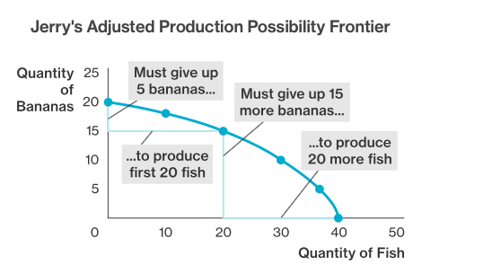

Slide 36
Constant Opportunity Cost
(PPF is linear):
Pizza
-As we move along the production possibility curve with increasing computer, constant unit of food must be forgone
30
20
15
10
5
A
B
PPF
C
D
CONSTANT OPPORTUNITY COST:
A to B = [(20 – 15)/(10 – 5)] = 1
C to D = [(10 – 5) /(20 – 150)] = 1
0
5 10 15 20
Calzions

Slide 37
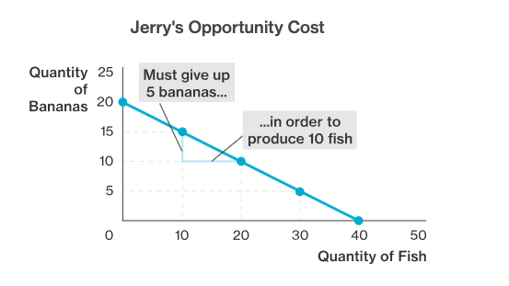
Constant Opportunity Cost
Shape of the curve

Slide 38
Shift in a PPC
Causes of shifts in PPC
Production outside of the frontier is not possible with current available resources.
However, if there is an increase in land, labor or capital (technology) then the frontier will shift outwards.
A shift out means that more of both products can be produced.

Slide 39
Consequences of a shift in the PPC
This shift represents potential economic growth (the curve itself)
A rise in economic output actual countries economic growth. Eg point Y
Y
X

Slide 40
Assignment class work
Watermelons (millions of tons) | Shoes (millions of pairs)
0 | 15
8 | 14
14 | 12
18 | 9
20 | 5
21 | 0
Create a production possibilities curve using the following data.
State the maximum number of shoes it can produce if it devotes all resources making shoes
Calculate the opportunity cost of increasing the output of watermelons 8 watermelons to 14 watermelons?

Slide 41
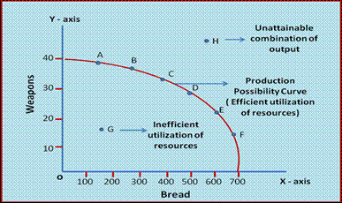

Slide 42
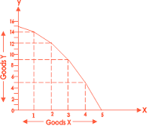
Tractors
Harvest Combines

Slide 43
Assignment: Cost-Benefit Analysis
Decision | Benefits | Opportunity Costs
1. Being on time to class
2. Buying a new cell phone
3. Working on Friday night
4. Sleeping late
5. Playing on the Butler basketball team
6. Graduating from high school
7. Being late for curfew
8. Not studying for a test

Slide 44
A Production Possibilities Table and Curve
A
1 pound of butter
15
B
14
2 pounds of butter
C
12
D
Butter
9
5
E
5 pounds of butter
F
0
4
7
9
11
12
Guns
4 guns
3 guns
1 gun

Slide 45
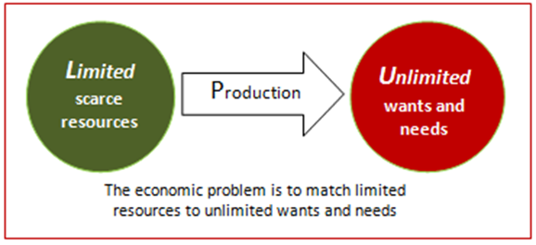
The BASIC ECONOMIC PROBLEM arises because resources are scarce, but human wants are unlimited.

Slide 46
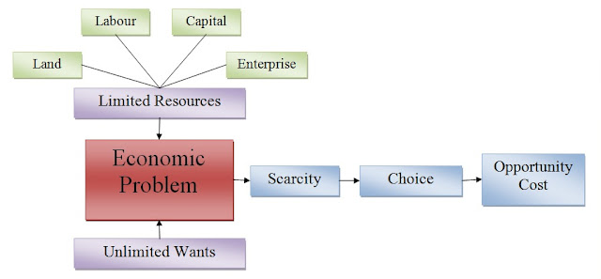

Slide 47
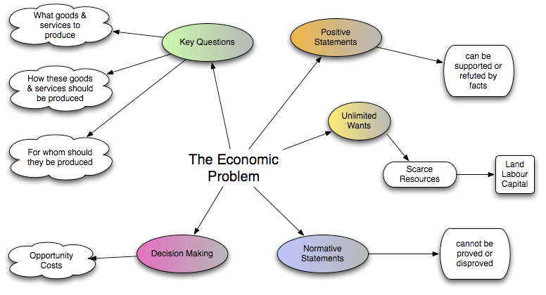

Slide 48


A public good is a good that is both non-excludable and non-rivalrous.
This means that individuals cannot be effectively excluded from its use, and use by one individual does not reduce its availability to others.
Examples of public goods include fresh air, knowledge, lighthouses, national defence, flood control systems, and street lighting .

Slide 49


Merit Goods
Merit goods are provided by the market but are likely to be over-priced and under-produced when compared to the socially desirable equilibrium.
This is because the market (consumers and producers) only consider the private benefit and costs whereas there are many positive externalities that result society consuming more merit goods.

Slide 50
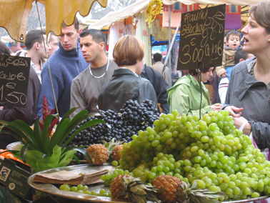
Consumption
Using up goods and services (products) to satisfy consumers’ needs and wants

